Slide 1
Bike - sharing
Project case study
By:-
Satish Kumar
Kodiganti Suresh
Pravalika Panchamurthi
INDUKURI LAXMI MOUNIKA
Chanukya K M
Chaitanya kamble
Subhranshu Sekhar

Slide 2
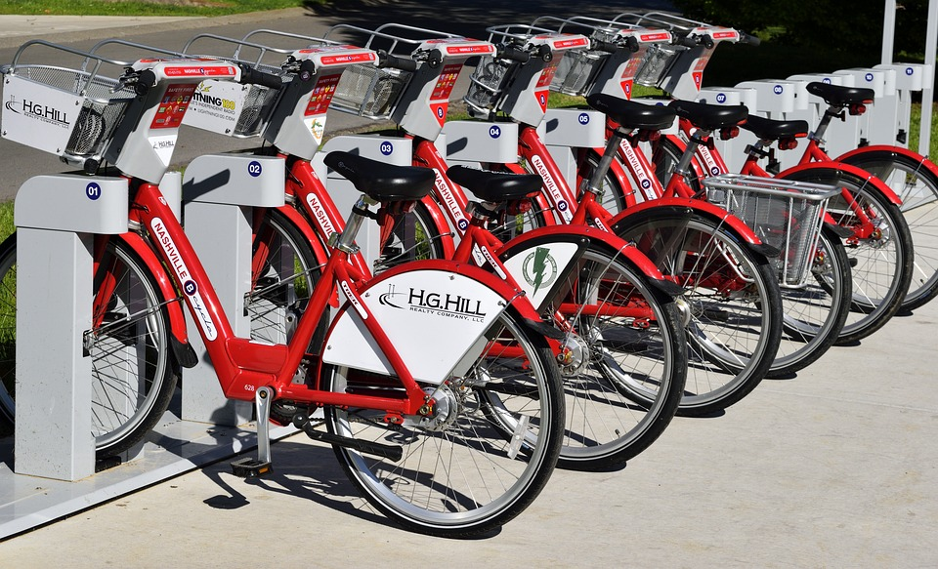

Slide 3
Business Use-case
A bike-sharing system is a service in which bikes are made available for shared use to individuals on a short term basis for a price or free. Many bike share systems allow people to borrow a bike from a "dock" which is usually computer-controlled wherein the user enters the payment information, and the system unlocks it. This bike can then be returned to another dock belonging to the same system.

Slide 4
Business Use-case
A US bike-sharing provider Boom Bikes has recently suffered considerable dips in their revenues due to the ongoing Corona pandemic. The company is finding it very difficult to sustain in the current market scenario. So, it has decided to come up with a mindful business plan to be able to accelerate its revenue as soon as the ongoing lockdown comes to an end, and the economy restores to a healthy state.

Slide 5
The company wants to know
Which variables are significant in predicting the demand for shared bikes.
How well those variables describe the bike demands.
Objective
To Build a Superior statistical model to predict the number of bikes that can be rented with availability of data.

Slide 6
STEPS
1. Importing Data
2. Exploratory Data Analysis (EDA)
3. Data Visualization
Distribution plots
Box plots
Bivariate, Trivariate and Multivariate plots
Pair plots
Correlation plots
Bar plots
4. Preprocessing the data
Standardization
Normalization
6. Assumptions
Linearity
Independence
Homoscedasticity
Normality
Influential Outliers
7. Model Evaluation
5. Model Building
Linear Regression
Recursive Feature Elimination
Random Forest Regression
Decision Tree Regressor
Support Vector Machine Regression
Lasso Regression
Elastic Net
Ridge Regression

Slide 7
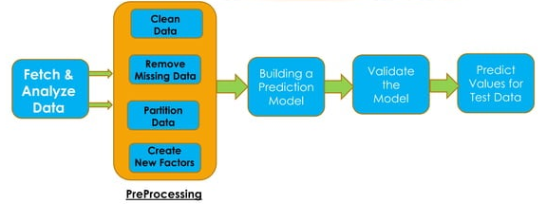
Methodology

Slide 8
Dataset Details
Dataset has 730 rows and 16 columns.
Except one column , all other columns are float and integer values.
The one column is date type.
We will analyze and finalize whether to convert them to categorical or treat as integer.

Slide 9
1. Importing Data
Import the required libraries.
Read the data from the input csv file.
Check the information of the dataset which includes the number of columns in the dataset and type of columns.
2. Exploratory Data Analysis (EDA)
Data Cleaning.
Checking the value counts for entire dataset. This will be help to identify any unknown or junk values present in the dataset.
We will create DUMMY variables for 4 categorical variables 'mnth', 'weekday', 'season' & 'weathersit’.
Before creating dummy variables, we will have to convert them into 'category' data types.

Slide 10
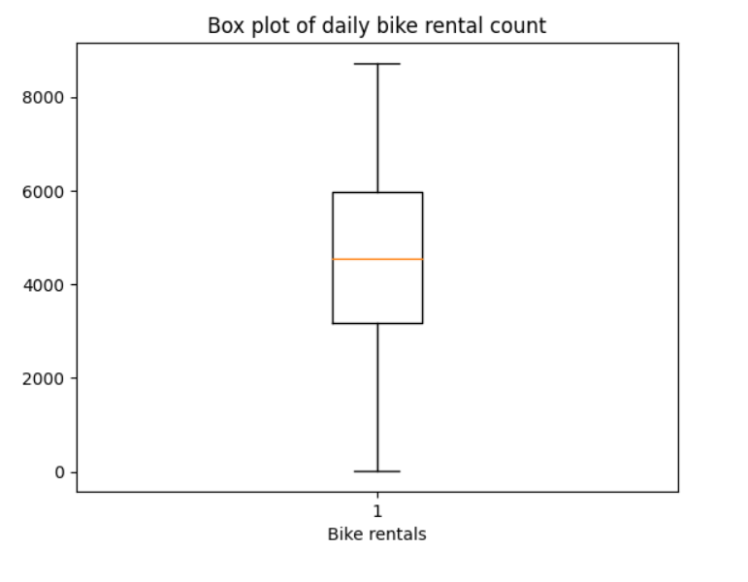
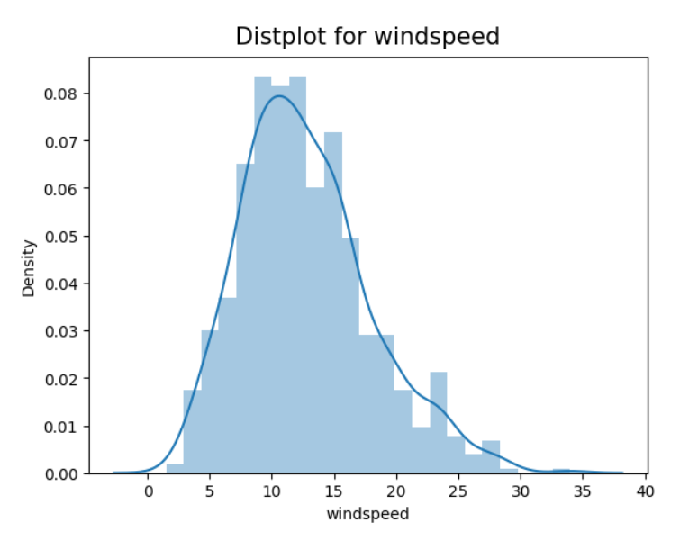
3. Data Visualization
BOX PLOT
DISTRIBUTION PLOT

Slide 11
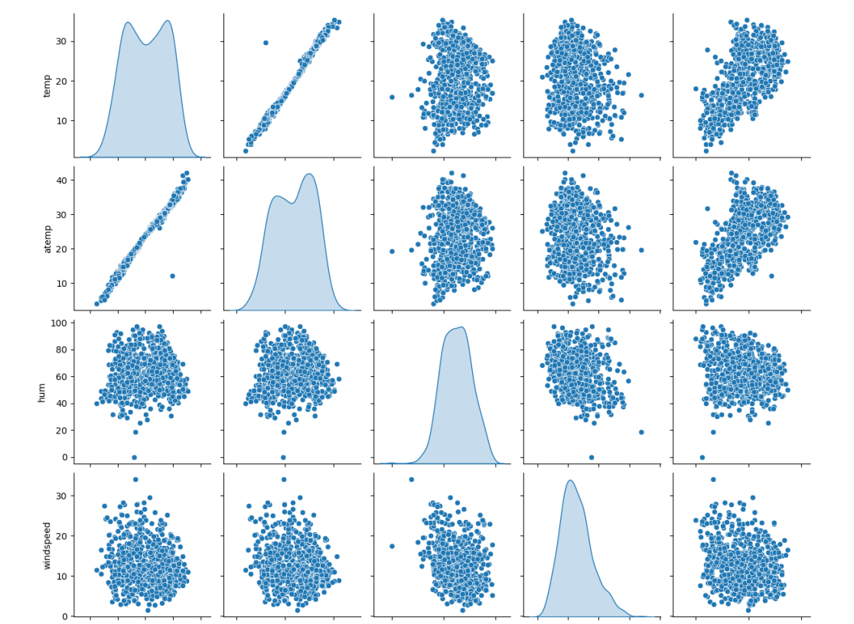
PAIR PLOT

Slide 12
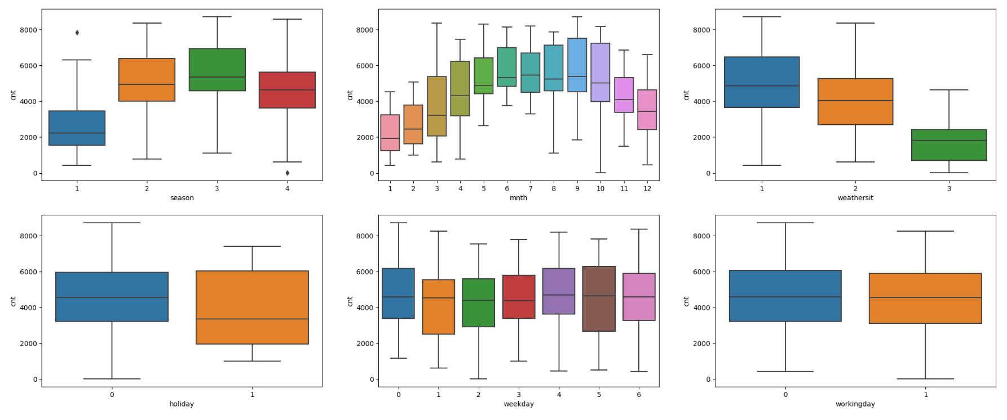
MULTIVARIATE PLOT

Slide 13
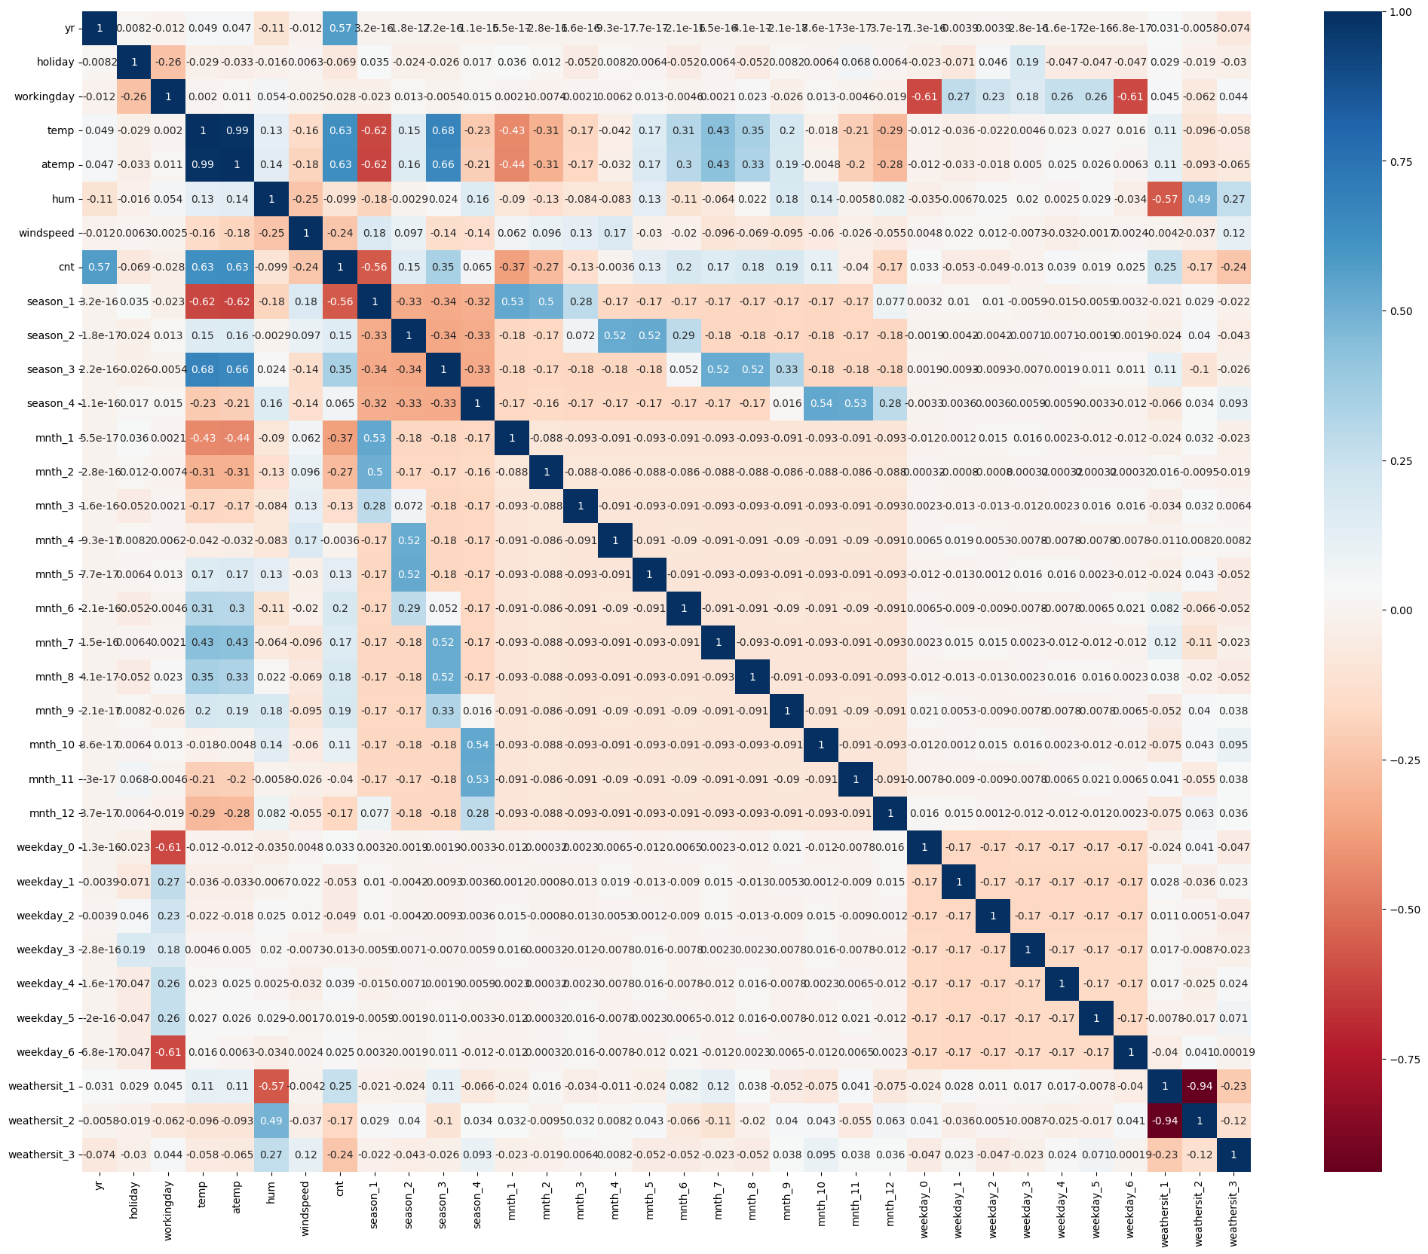
Correlation PLOT

Slide 14
4.Preprocessing the data
Splitting the data into train and test data sets.
We will split the data into bike train and bike test(70:30 ratio) respectively.
Normalize the bike train dataset.
Split the bike train dataset into x and y.

Slide 15
5. Model BUILDING
Model 1
Running RFE with the output number of the variable equal to 15.
Creating X_test data frame with RFE selected variables.
Check for the VIF(Variance Inflation Factor) values of the feature variables.
Create a data frame that will contain the names of all the feature variables and their respective VIFs

Slide 16
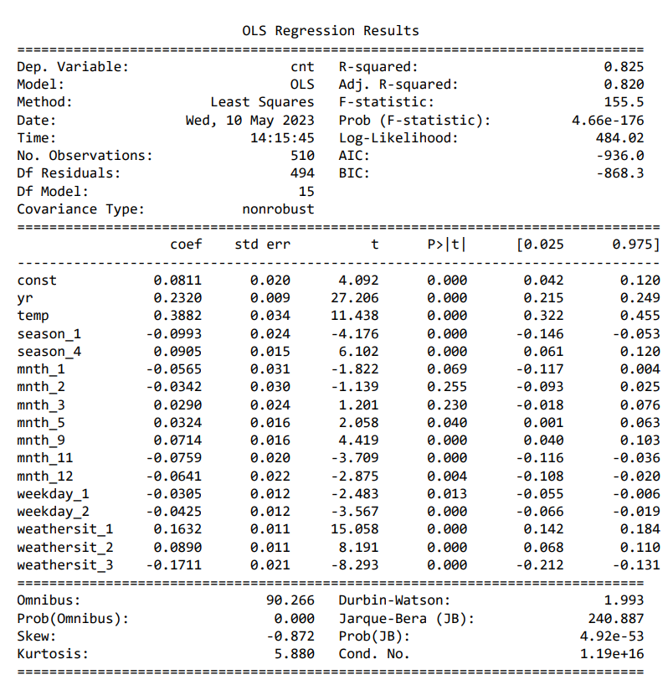
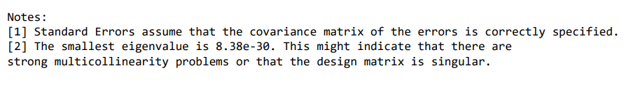

Slide 17
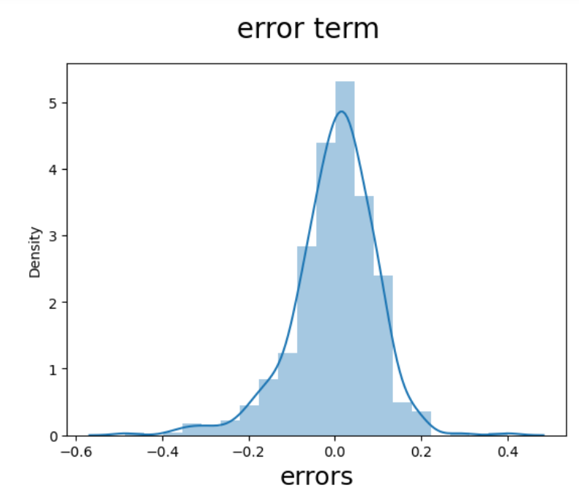
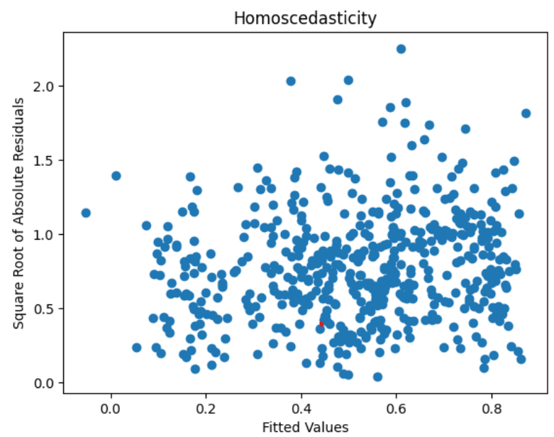
6. Assumptions
CHECK FOR LINEARITY
CHECK FOR HOMOSCEDASTICITY

Slide 18
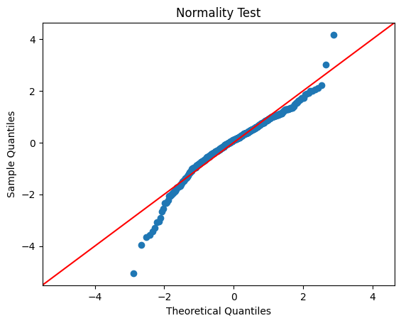
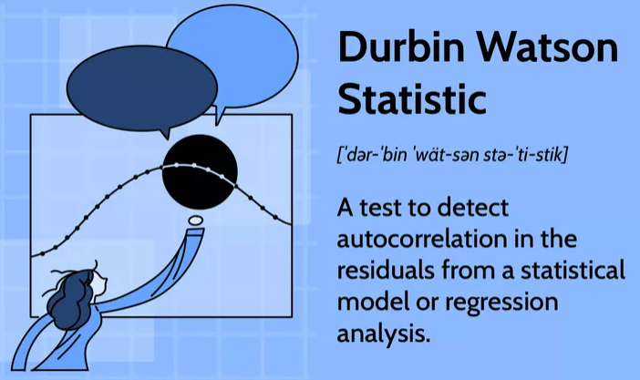
CHECK FOR NORMALITY
CHECK FOR INDEPENDENCE

Slide 19
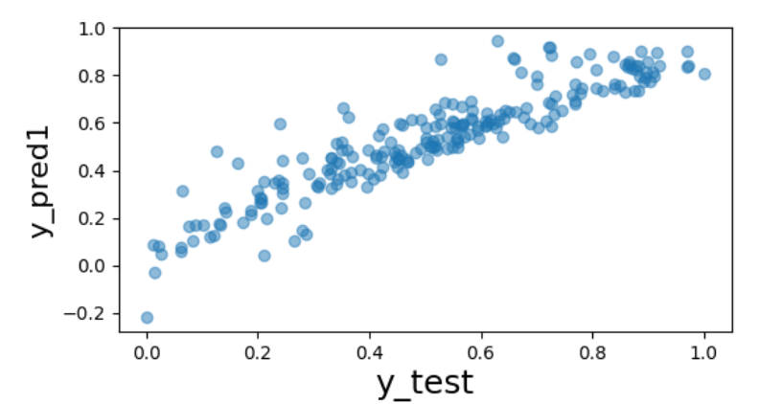
7. MODEL EVALUTION
Plotting y_test and y_pred to understand the spread.

Slide 20
RIDGE, Lasso and ElasticNet Regression Model
Fitting a ridge regression model.
Polynomial Regression - 2nd degree.
Laso regression model fit.
Fit ElasticNet model.
Support Vector Machine(SVM) Regressor
Fitting fitting a SVM Regressor.

Slide 21

Deployment
Polynomial Regression - 2nd degree.
We Have concluded the Polynomial model as final model to use based on the accuracy and R2 scores we have seen as an out of the model.
We have created a pickle file with the above model and prepared streamlit deployment code so that a webpage can be used to test the functionality of the given bike rental analysis model

Slide 22
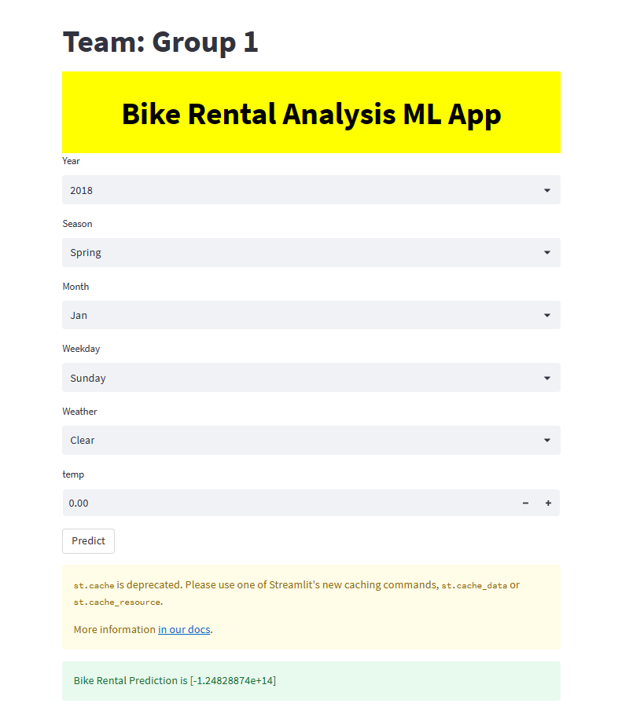
RESULT

